Slide 1
DSD Project Presentation
Design and Implementation of FIFO Memory
Submitted by :
TANUMON ROY (174259)
HARISH PATIDAR (174213)
Submitted to :
Dr. V. Narendar
Dr. M. Satish

Slide 2
FIFO Memory
Every memory in which the data word that is written in first also comes out first when the memory is read is a first-in first-out memory. There are three kinds of FIFO:
• Shift register – FIFO with an invariable number of stored data words and, thus, the necessary synchronism between the read and the write operations because a data word must be read every time one is written
• Exclusive read/write FIFO – FIFO with a variable number of stored data words and, because of the internal structure, the necessary synchronism between the read and the write operations
• Concurrent read/write FIFO – FIFO with a variable number of stored data words and possible asynchronism between the read and the write operation

Slide 3
Sync FIFO using shared clock
Synchronous FIFOs are controlled based on methods of control proven in processor systems. Every digital processor system works synchronized with a system-wide clock signal. This system timing continues to run even if no actions are being executed. Enable signals, also often called chip-select signals, start the synchronous execution of write and read operations in the various devices, such as memories and ports.

Slide 4
Uses of FIFO memory
Storing a row of video data
Receiving data from a high speed serial interface
Buffering data for transmit out of a UART to software
Buffering data to/from SDRAM interface
Crossing clock domains

Slide 5
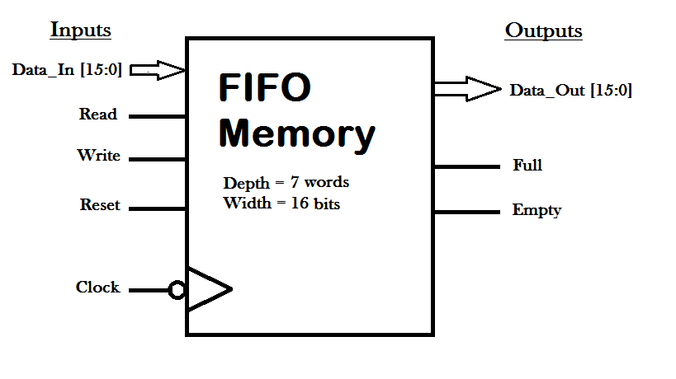
Block Diagram

Slide 6
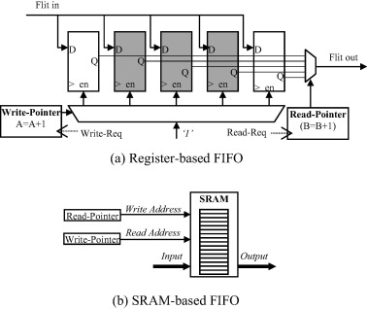
Two types of FIFO designs

Slide 7
Code Level
Presented here is the code for FIFO design using Verilog (Behavioral Level modelling) that is simulated using Xilinx VIVADO 2018.3 software. In this project, we design and implement FIFO using different read and write logics. We have considered each input data to be 16 bits wide and the maximum depth of the FIFO memory is taken as 7 words

Slide 8
START
initialize everything to zero
rst == 1'b0
read && ! empty
write && ! full
d_out<=fifo[head] head++ count--
fifo[tail]<=d_in tail++ count++
count == MAX_COUNT
full <= 1'b1
count==0
empty <= 1'b1
Flowchart
0
1
0
0
1
1
0
0
1
1

Slide 9
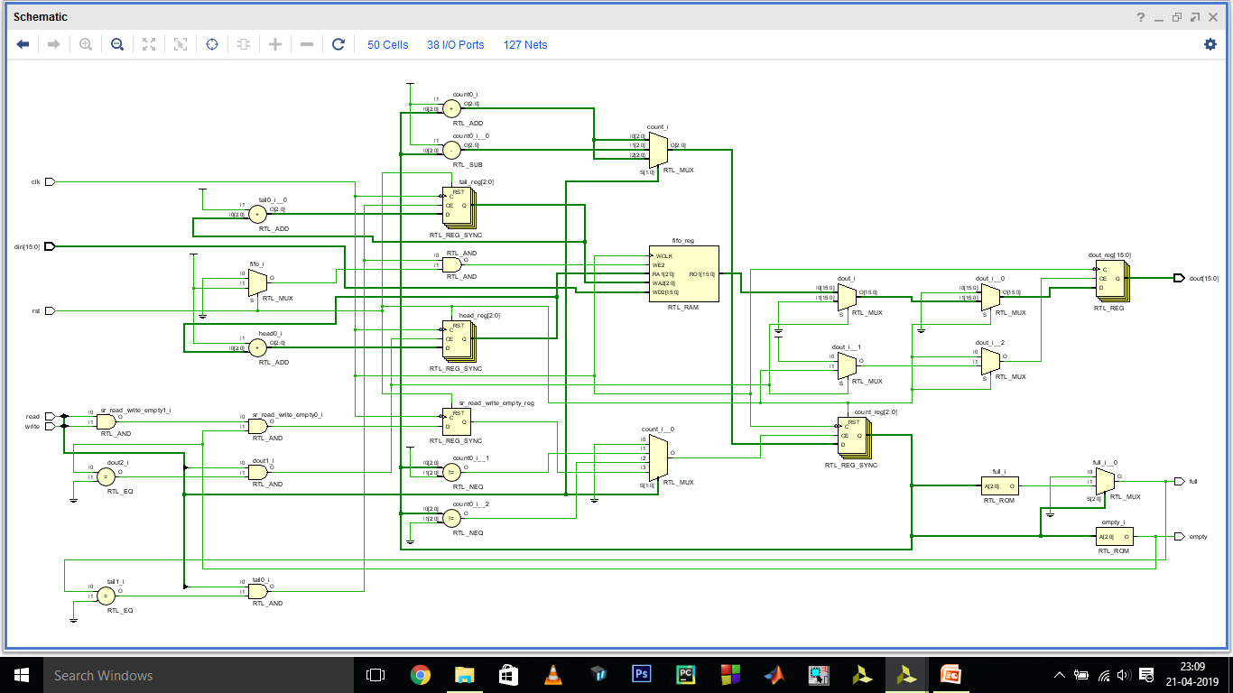
RTL Schematics

Slide 10
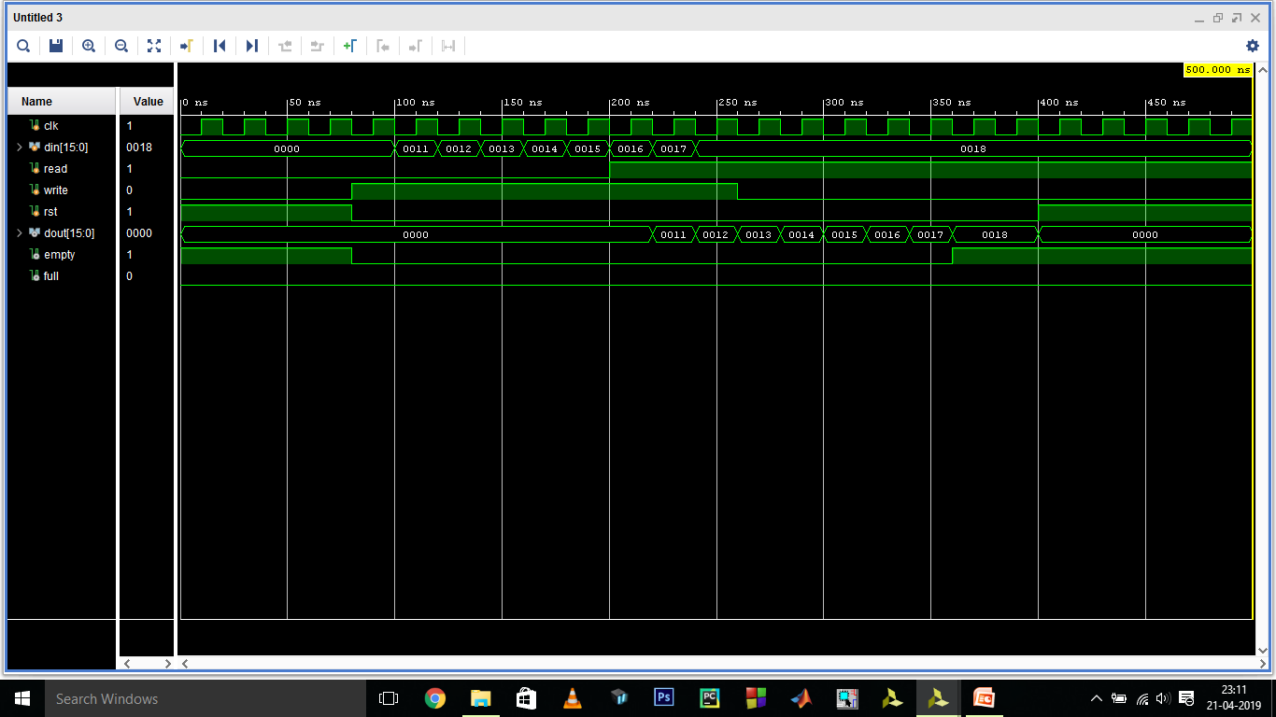
Simulation Results

Slide 11
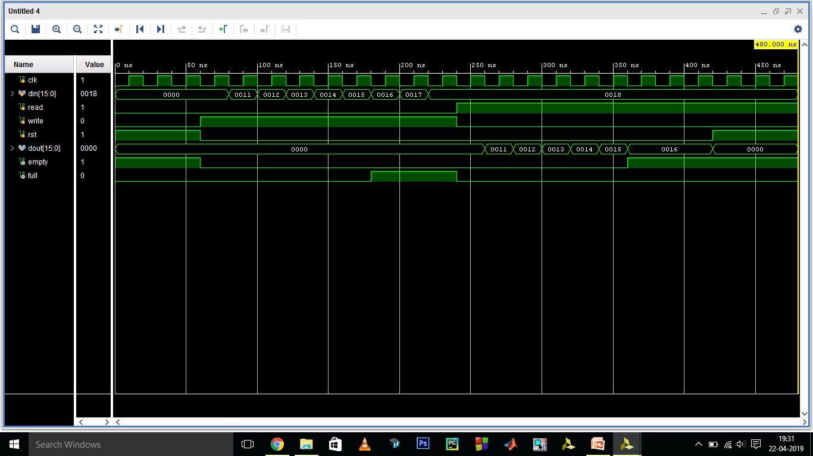
Simulation Results

Slide 12
Synthesis Report
Click Here to view the report generated after running the synthesis for the concerned FIFO memory design code in Verilog using the Xilinx VIVADO 2018.3 software.

Slide 13
Thank You... ☺

